Slide 1
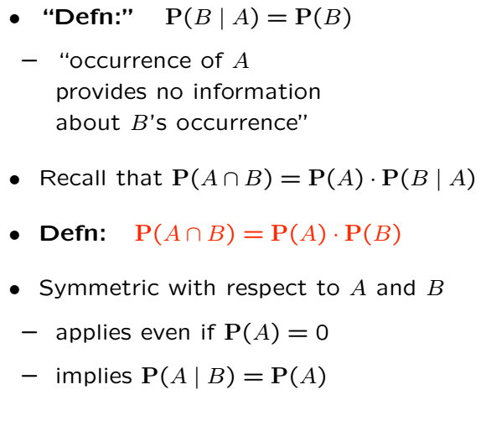
Independence of Events

Slide 2



Independence is Different than Disjointness
Disjoint:
If disjoint,
If disjoint, events cannot occur at same time.
Independence:
If independent, occurrence of one event has no influence on the occurrence of the other.
Independence model captures sequence of dice rolls or sequence of coin tosses

Slide 3
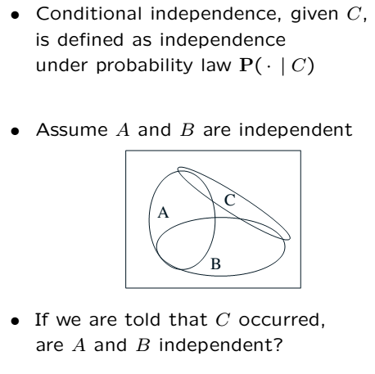
Conditioning May Ruin Independence

Slide 4

Recall Independence
A coin with
Flip a coin 10 times
We model flips as independent

Slide 5

Conditioning and Independence
Removing conditioning may ruin independence.
Two unfair coins
Choose either with equal probability and perform 10 independent flips. (flips indep. cond. on chosen coin)
Intuition: because the first 9 tosses carry info on which coin is chosen.

Slide 6
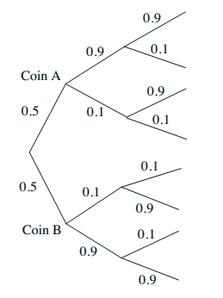
Conditioning and Independence Cont’
Removing conditioning may ruin independence
We show by calculation in the following
HH
HT
Recall given coin, flips are independent
A new version of prev. example with two flips
If we don’t know which coin, are flips indep?
Let’s calculate prob.
TH
TT
HH
HT
TH
TT

Slide 8
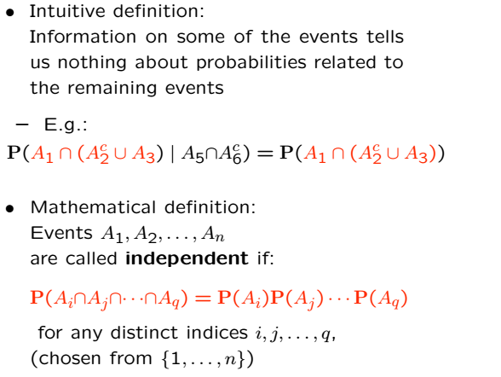
Independence of a Collection of Events

Slide 9
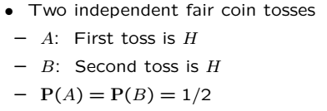
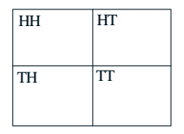
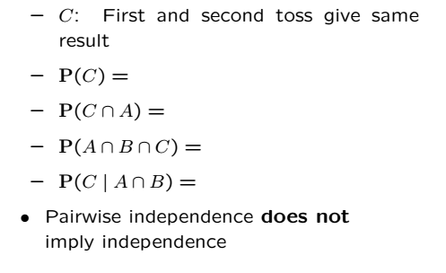
Pairwise Independence

Slide 11
Acknowledgements and Citations
Parts of these slides are adapted from the following resources:
Power Point Lecture Slides for the Textbook http://bcs.wiley.com/hebcs/Books?action=index&bcsId=8676&itemId=1118324560
John Tsitsiklis. 6.041 Probabilistic Systems Analysis and Applied Probability, Fall 2010. (Massachusetts Institute of Technology: MIT OpenCourseWare),http://ocw.mit.edu (Accessed 13 Apr, 2015). License: Creative Commons BY-NC-SA

